Slide 1
8085 MPU Architecture
JIIT-128, Noida

Slide 2
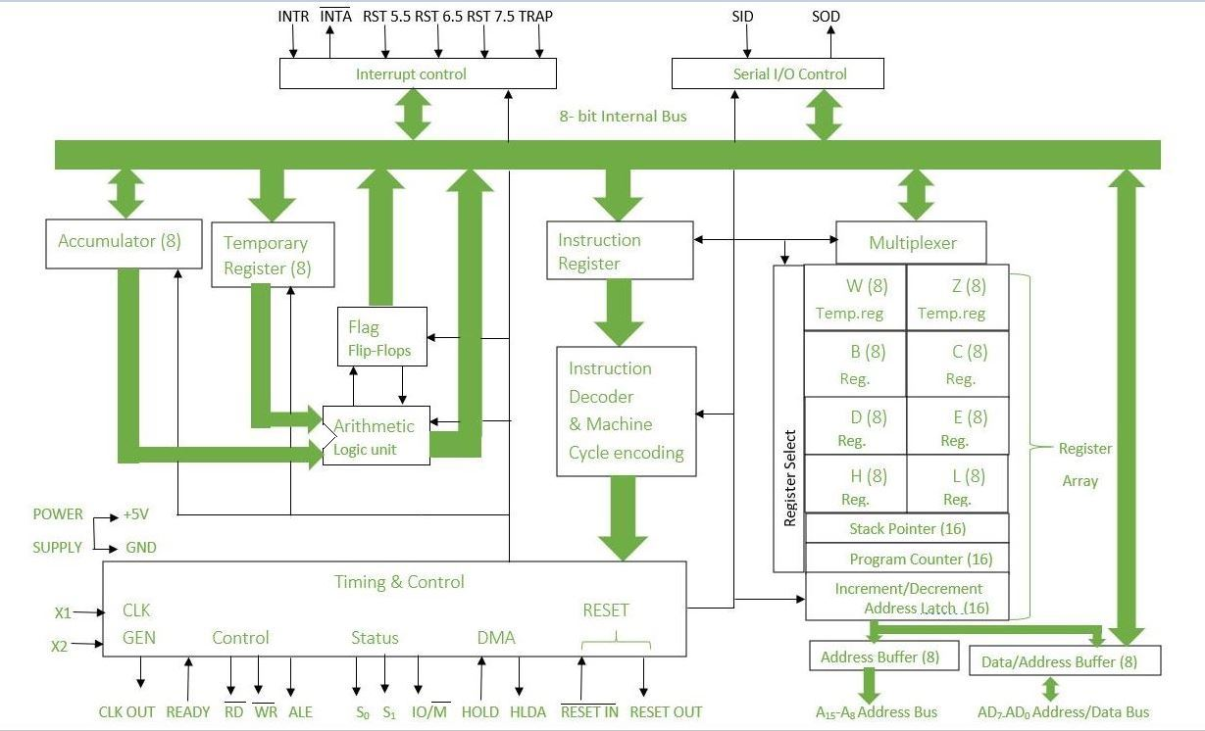
8085 MPU Architecture
Figure 1 [1]
JIIT-128, Noida

Slide 3
Control Unit
Generates signals within uP to carry out the instruction, which has been decoded.
Causes certain connections between blocks of the uP to be opened or closed, so that data goes where it is required, and so that ALU operations occur.
JIIT-128, Noida

Slide 4
Arithmetic Logic Unit
The ALU performs the actual numerical and logic operation such as ‘add’, ‘subtract’, ‘AND’, ‘OR’, etc.
Uses data from memory and from Accumulator to perform arithmetic.
Always stores result of operation in Accumulator.
JIIT-128, Noida

Slide 5
Registers
The 8085/8080A-programming model includes six registers, one accumulator, and one flag register, as shown in Figure.
In addition, it has two 16-bit registers: the stack pointer and the program counter.
The 8085/8080A has six general-purpose registers to store 8-bit data; these are identified as B,C,D,E,H, and L
They can be combined as register pairs - BC, DE, and HL - to perform some 16-bit operations.
The programmer can use these registers to store or copy data into the registers by using data copy instructions.
JIIT-128, Noida

Slide 6
Accumulator
The accumulator is an 8-bit register that is a part of arithmetic/logic unit (ALU).
This register is used to store 8-bit data and to perform arithmetic and logical operations
The result of an operation is stored in the accumulator.
The accumulator is also identified as register A.
JIIT-128, Noida

Slide 7
Flags
The ALU includes five flip-flops, which are set or reset after an operation according to data conditions of the result in the accumulator and other registers.
They are called Zero(Z), Carry (CY), Sign (S), Parity (P), and Auxiliary Carry (AC) flags.
The most commonly used flags are Zero, Carry, and Sign. The microprocessor uses these flags to test data conditions.
These flags have critical importance in the decision-making process of the microprocessor.
For example, the instruction JC (Jump on Carry) is implemented to change the sequence of a program when CY flag is set.
JIIT-128, Noida

Slide 8
Program Counter (PC)
This 16-bit register deals with sequencing the execution of instructions.
This register is a memory pointer.
Memory locations have 16-bit addresses, and that is why this is a 16-bit register.
The microprocessor uses this register to sequence the execution of the instructions.
The function of the program counter is to point to the memory address from which the next byte is to be fetched.
When a byte (machine code) is being fetched, the program counter is incremented by one to point to the next memory location
JIIT-128, Noida

Slide 9
Stack Pointer (SP)
The stack pointer is also a 16-bit register used as a memory pointer.
It points to a memory location in R/W memory, called the stack.
The beginning of the stack is defined by loading 16-bit address in the stack pointer
JIIT-128, Noida

Slide 10
Instruction Register/Decoder
Temporary store for the current instruction of a program.
Latest instruction sent here from memory prior to execution.
Decoder then takes instruction and ‘decodes’ or interprets the instruction.
Decoded instruction then passed to next stage.
JIIT-128, Noida

Slide 11
Memory Address Register
Holds address, received from PC, of next program instruction
Feeds the address bus with addresses of location of the program under execution.
Control Generator
Generates signals within uP to carry out the instruction which has been decoded.
Causes certain connections between blocks of the uP to be opened or closed, so that data goes where it is required, and so that ALU operations occur.
JIIT-128, Noida

Slide 12
Register Selector
This block controls the use of the register stack
Just a logic circuit which switches between different registers in the set will receive instructions from Control Unit.
General Purpose Registers
uP requires extra registers for versatility.
Can be used to store additional data during a program.
More complex processors may have a variety of differently named registers
JIIT-128, Noida

Slide 13
References
Gaonkar, R. S. (1990). Microprocessor Architecture, Programming and Applications with the 8085. Fifth Edition Prentice Hall PTR.

